Slide 1
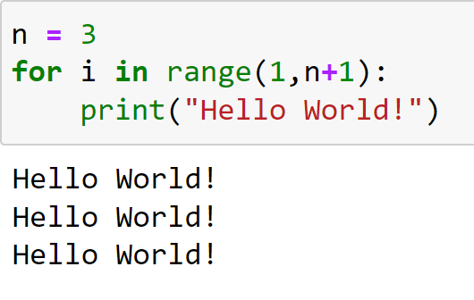
Introduction to Loops Programming and Algorithms
Lecture by
Dr Daniil Osudin

Slide 3
What will we Cover?
Introduction to the concept of loops
Purpose of loops in programming

Slide 4
Why do we Need Loop Constructs?
There are problems that require us to repeat the same action multiple times to solve them
For example
Cooking pancakes steps
Mix ingredients
For each pancake
Pour batter onto the frying pan
Cook until edges are brown
Flip and cook the other side

Slide 5
Purpose of Loops in Programming?
Iteration is repeated execution of a statement or statements
Loops are used to carry out iterations
Perform a large number of calculations with small number of statements
Example
Count the number of words in a text until the end of the page is reached

Slide 6
Purpose of Loops in Programming?
Parts of a loop
Condition to be met for loop continuation
Start and finish of the process to be repeated
Loops available in Python
WHILE loop
FOR loop

Slide 7
Examples of Loops
Computer games
Each time interval in the game, the positions of the characters are changed to new positions
start game input
game over?
No
display the game
start
update game state
Yes
game over screen
end

Slide 8
Examples of Loops
Word counter
Count the number of words in a text until the end of the page is reached
text over?
No
total += 1 skip to next word
start
read text
Yes
display the total
end

Slide 9
Examples of Loops
Key search
Find if any one of the elements in a list has the same value as the key entered
list over?
No
No
skip to next element
start
read key
value == key?
Yes
Yes
end
print “key not found”
print “key found at position i”
end

